Slide 1
Secure Data Hiding In Images Using Steganography
CAPSTONE PROJECT
Presented By: Yupal Chaudhari
Student Name: Yupal Chaudhari
College Name: CSPIT , Charusat university
Department : Computer Engineering

Slide 2
OUTLINE
Problem Statement
Technology used
Wow factor
End users
Result
Conclusion
Git-hub Link
Future scope

Slide 3
Problem Statement
Traditional encryption methods can be easily identified, drawing unwanted attention.
A steganographic approach is needed to securely conceal messages within images.
Ensuring data protection by modifying full RGB channels while keeping image quality intact.
Offering an easy-to-use encryption and decryption process for both technical and
non-technical users.

Slide 4
Technology used
Programming Language:
Python 3 – The entire project is written in Python.
Libraries Used:
OpenCV (cv2) – For image reading, processing, and saving.
OS (os) – For handling file execution and system commands.
Platforms Supported:
Windows – Supports os.system("start ...") for opening files.
Image Processing Technique:
Steganography – Hides secret messages by modifying pixel values.
Full Pixel Channel Encoding – Stores ASCII values directly in the RGB channels instead of
modifying just the Least Significant Bit (LSB).

Slide 5
Wow factors
Full-Channel Encoding: Unlike traditional LSB steganography, this method utilizes entire pixel values (RGB) for message storage, enhancing security.
Universal Image Support: Works with JPG, PNG, BMP, and other formats by converting images to PNG for lossless encryption.
Password-Protected Decryption: Ensures only authorized users can extract hidden messages, adding an extra layer of security.
Undetectable Steganography: The message remains invisible to the human eye, maintaining the original appearance of the image.
Lightweight & Fast: Uses Python and OpenCV, making it efficient, with minimal processing time.

Slide 6
End users
Cybersecurity Enthusiasts & Researchers – To explore steganography techniques for secure communication.
Privacy-Conscious Individuals – Users who need to hide sensitive data in images without drawing attention.
Law Enforcement & Forensic Experts – For covert communication and digital investigations.
Journalists & Whistleblowers – To securely share confidential information in restrictive environments.
Students & Developers – To learn about image processing, encryption, and steganography concepts.

Slide 7
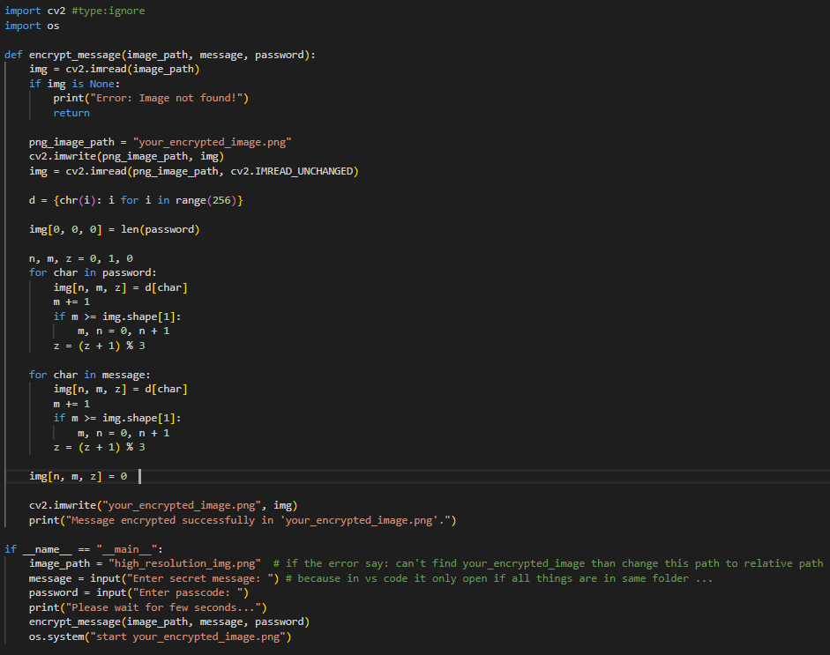
Results
Encryption Code:

Slide 8
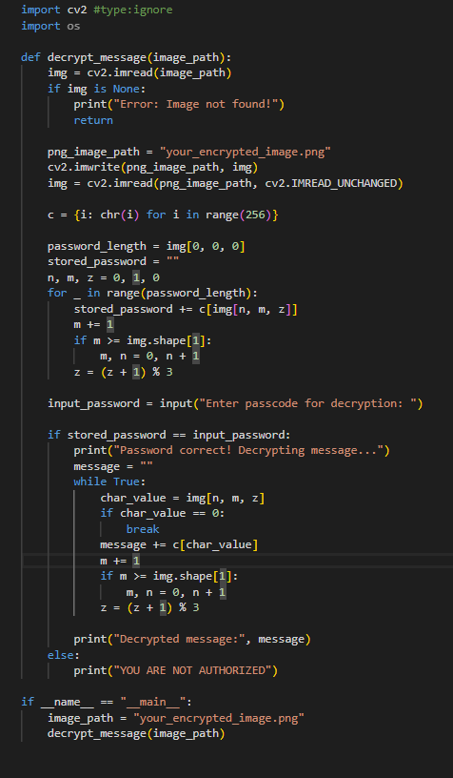
Results
Decryption Code:

Slide 9
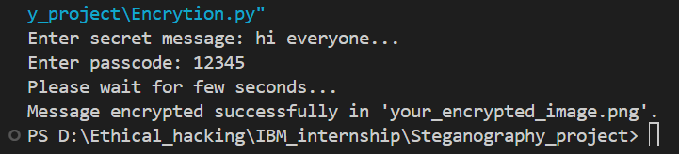
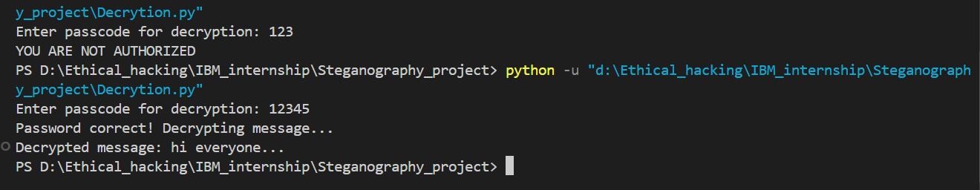
Results
Code execution:
Encryption:
Decryption:

Slide 10
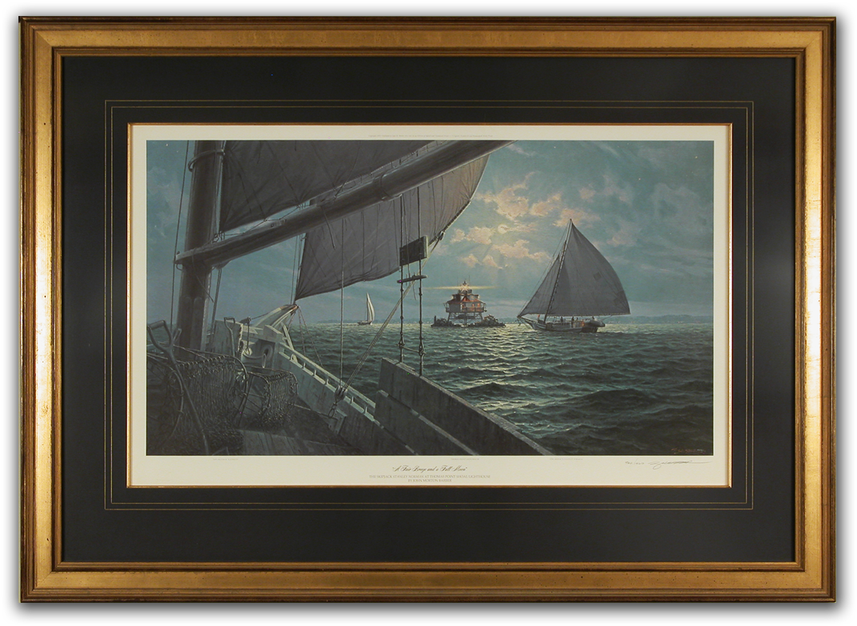

Results
High_resolution_image:
Encrypted_image:

Slide 11
Conclusion
This project successfully implements image-based steganography by embedding secret messages into the full RGB channels of an image, ensuring security while maintaining visual integrity. By supporting multiple image formats and enforcing password-protected decryption, it provides a stealthy and reliable method for secure communication.
With its ease of use, cross-platform compatibility, and advanced encoding technique, this system is a powerful tool for privacy protection, cybersecurity research, and secure messaging. It demonstrates how steganography can enhance data security while remaining undetectable to unauthorized users.

Slide 12
GitHub Link
https://github.com/yupalchaudhari/Steganography.git

Slide 13
Future scope
LSB-Based Steganography Option – Implementing traditional Least Significant Bit (LSB) encoding for better comparison and flexibility.
Enhanced Image Format Support – Improving compatibility with more formats like WebP, TIFF, and GIF while maintaining security.
Encryption Before Embedding – Adding AES or RSA encryption to further secure the hidden message before encoding.
Mobile & Web Integration – Developing a mobile app or web-based tool for easy access and usability.
AI-Based Detection Prevention – Implementing adversarial techniques to make detection by AI steganalysis tools even harder.
Higher Capacity Encoding – Optimizing storage techniques to embed larger messages without noticeable image distortion.

Slide 14
THANK YOU

